Slide 1

Assistive Paintbrush Device for Limited Dexterity Artists
Kylie Greulich, Kris Nair, and Violet Ullman
BMEG 360 Final Pitch
May 21, 2020
Notes:
Kylie: Hi everyone! We are team 15 (Kylie, Kris, and Violet) and we are excited to share with you our solution for increasing independence in limited dexterity artists using an assistive paintbrush device.

Slide 2
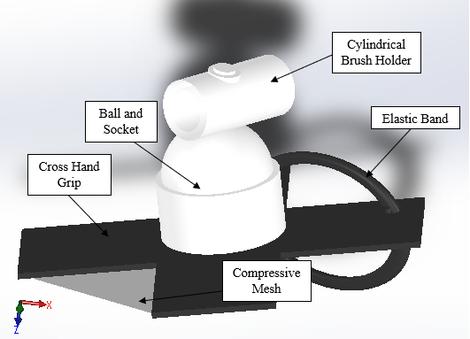
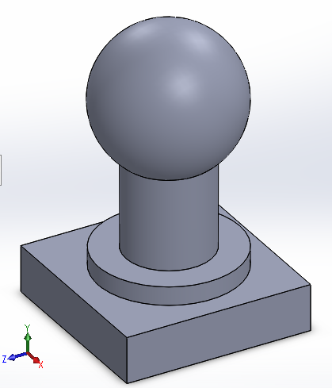
Final Design
3 components
Cross hand grip
Ball and socket controlled by joystick
Cylindrical brush holder
Notes:
Kylie: Shown here is a 3D rendering of our final design. The left image shows the device the artist will be wearing and the right image shows the joystick that the artist will use with their other hand to control the angle of the device and the paintbrush it is holding. The user will slide their hand through the elastic band and the compressive mesh and wrap the straps of the cross hand grip around the sides of their hand as this material is made of armature wire covered in soft PLA and is able to bend and maintain its position. Once the device is secure, with the ball and socket sitting on top of the hand, the paint brush of choice can be inserted into the cylindrical brush holder and locked into place. Finally, the movement of the ball and socket controlled by the joystick, will allow the user to adjust the angle of the paint brush. Kris and Violet will discuss these components in more detail.

Slide 3
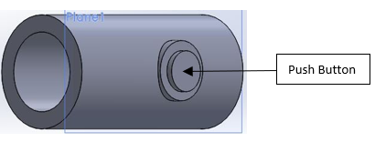
Cylindrical Brush Holder
User inserts brush into holder and pushes button to lock into place
Button latches brush against extrusion in holder
Increases user independence
Notes:
Kris: The first component that we want to focus on is the cylindrical brush holder. So how this works is the user inserts the brush at the opening, gets the brush into a comfortable position, and then pushes the button that locks the brush into place. When the button is pushed it latches the brush against an extrusion locking it into place. The benefit of this component is that it increases user independence and allows the user to swap brushes with the push of a button.

Slide 4
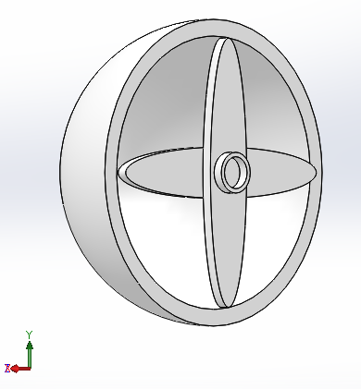
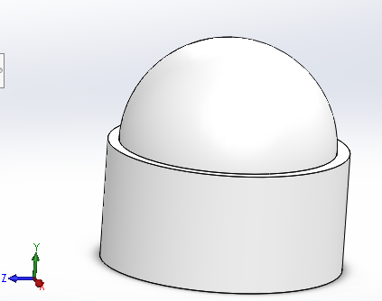
Joystick Control of Ball-and-Socket
Joystick controls 2 servo-motors located in the ball and socket
Allows for 180° translation in each the x and y dimensions, increasing adjustability
Ball and Socket
Inside of Ball
with axes
Notes:
VIOLET
Next we have the ball and socket joint, which is controlled by a joystick. The joystick module is controlled by an Arduino circuit that makes use of two-servo motors. These servo-motors attach to the axes shown on the right, inside the ball. When the user moves the joystick, it changes the position of two potentiometers, which in turn move the servo motors. This allows the ball to move freely in the cylinder socket shown on the left. This movement is what controls the brush’s position, as the cylindrical brush holder sits on top - allowing the user to paint with minimal effort.

Slide 5
Verification and Validation
Different testing methods
System level, component level, material analysis
Priority | Want | Pass/Fail
1 | Low Cost of Production | Pass
2 | Lightweight | Predicted Fail
3 | Portability | Pass
4 | Durability/Reusable | Predicted Pass
5 | Easily found replacement parts | Pass
6 | Easy to use | Predicted Pass
7 | Easy to clean | Predicted Pass
8 | Aesthetically and sensory pleasing | Predicted Fail
Priority | Constraint | Pass/Fail
Need | Safety | Predicted Pass
Need | Compatibility | Predicted Pass
Need | Adjustability | Predicted Pass
Notes:
KRIS: To test our metrics, we used system level testing, component level testing, and material analysis testing. The majority of the metrics that passed were from material analysis testing, for example a testing protocol to be free of allergens. For other tests, we had to predict results based on system and component design, for example lock security, where we couldn’t physically test the brush holder itself but we can predict a pass based on the design details. We did predict to fail the lightweight and aesthetics metrics only because our device has a lot of circuitry that adds weight and the shape of the device is not exactly appealing to the eyes.

Slide 6
Path Forward
Continued development of prototype
Materials to decrease weight
Improve appearance
Paint or more streamlined look
Build physical prototype
Complete testing
Use with artists at ATE
Make improvements based on testing results
Implement device for use at ATE
Notes:
VIOLET
Moving forward, we would like to continue to develop our prototype so that it meets all of our constraints and wants. This includes investigating specific materials that may decrease the overall weight of the device, and finding ways to streamline our design to make it more colorful and aesthetically pleasing. We would also hope to build a physical prototype once current restrictions are lifted, so that we can gain valuable insight that simply is not possible with a virtual design process. This includes completing mechanical tests and prototype test-runs with artists at ATE. We could then continue to make improvements and possibly implement our device for regular use at ATE.

Slide 7
Key Takeaways
Allows for adjustability
Different artists
Different paint brushes
Angle of paintbrush
Increased independence of artists with limited dexterity
Artists can express themselves fully
Notes:
Kylie: Overall, this design allows for a great deal of adjustability. It is able to fit different artists hands, various paint brush sizes can be used with it, and the angle of the paintbrush can be adjusted with the use of the joystick. We are confident that this design will allow for increased independence of artists with limited dexterity and artists will be better able to fully express themselves while using the device.

Slide 8
Thank You!
Notes:
Kylie: Thank you to our sponsor, ATE. Thank you Lisa and Hailey for your time and inspiration. We would also like to thank Dr. Scott, Dr. Rooney, and our TAs for their support and guidance. We are happy to answer any questions you might have.

